Slide 1
HL7 Clinical Genomics –
Domain Information Model
The HL7 Clinical Genomics Work Group
Prepared by Amnon Shabo (Shvo), PhD
HL7 Clinical Genomics WG
Co-chair and Modeling Facilitator
Pedigree (family health history) Co-editor
GTR Implementation Guide Primary Editor
HL7 Structured Documents WG
CDA R2 Co-editor
CCD Implementation Guide Co-editor

Slide 2
Overview of Activities
Main efforts: (chronologically ordered)
v3:
Family History (Pedigree) Topic
Deprecated:
Genetic Locus / Loci
Genetic Variations Topic
Gene Expression Topic
v2:
v2 Implementation Guides
* The IG “Genetic Test Result Reporting to EHR” is modeled after the HL7 Version 2.5.1 Implementation Guide: Orders And Observations; Interoperable Laboratory Result Reporting To EHR (US Realm), Release 1
CDA:
A CDA Implementation Guide for Genetic Testing Reports (GTR)
Under Development:
FHIR:
Genomic resources
Genetic family history profile
Normative DSTU Informative
Common:
Domain Analysis Models
Domain Information Model (DIM) describing the common semantics
DIM is standards-independent; Semantic alignment among the various specs

Slide 3
CG Domain Information Models (DIMs)
Represent agreed-upon and common CG semantics
Are aligned with the CG DAM requirements and models
A focal point to align the various CG specifications
Balloted in 9/2014 at informative level
  Consisted of two models:
    Clinical Genomics Statement (CGS)
      A specialization of the HL7 Clinical Statement model
      An extension of the GTR Clinical Genomics Statement
    Family Health History (utilizing the CGS)
  Passed, as follows: Aff. : 29, Neg.: 12, Abst.: 69, NV: 24
  All comments regarding CGS - reconciled (need to reconcile Pedigree)

Slide 4
Goals
Top-down conceptual model aligns bottom-up designed specs
Glossary (e.g., what is mutation and when it should be used)
Concrete standards can match pieces of the puzzle, and further detail / constrain them

Slide 5
Modeling Interplays – Informing Each Other
DAM
CG Information Modeling (IM)
DIM(s)
FHIR
CDA
v2
Others
Profiles
Templates
IGs

Slide 6
Clinical Genomic Statement - Core Principles
  Explicit representation of a 'genotype-phenotype' association
    The association should not be pre-coordinated, that is, a phenotype is not represented as part of some genetic variation representation, e.g., a genetic biomarker is an explicit association of two distinct observations and there is no pre-coordination of the interpretation into a single biomarker code
  The association is a many-to-many relationship, e.g., a genetic variation can be associated with several phenotypes and a phenotype could be associated with multiple ‘genotypes’

Slide 7
Genetic Observations
Capture various types of data, from known mutations to sequencing-based variations (e.g., somatic mutations in tumor tissues) to structural variations (e.g., large deletions, cytogenetics) to gene expression and so forth
The core class GeneticObservation contains data that is not the result of downstream analysis, i.e., that cannot be derived analytically from another observation available to performer
Link to GeneticObservationComponent class (zero to many) enables the post-coordination of any core data item (e.g., HGVS string) to its unambiguous basic primitives
Enabling encapsulation of key raw omics data that is the basis of creating this clinical genomics statement
The encapsulated data can have links to the full-blown omics data (e.g., NGS sequencing data)

Slide 8
Phenotypes
Phenotype class can be subtyped to distinguish between predictive phenotype and observed
Prediction is represented as a distinct observation with its own attributes such as time, method, performer, etc.
Links to knowledge sources / methods / services used for the interpretation

Slide 9
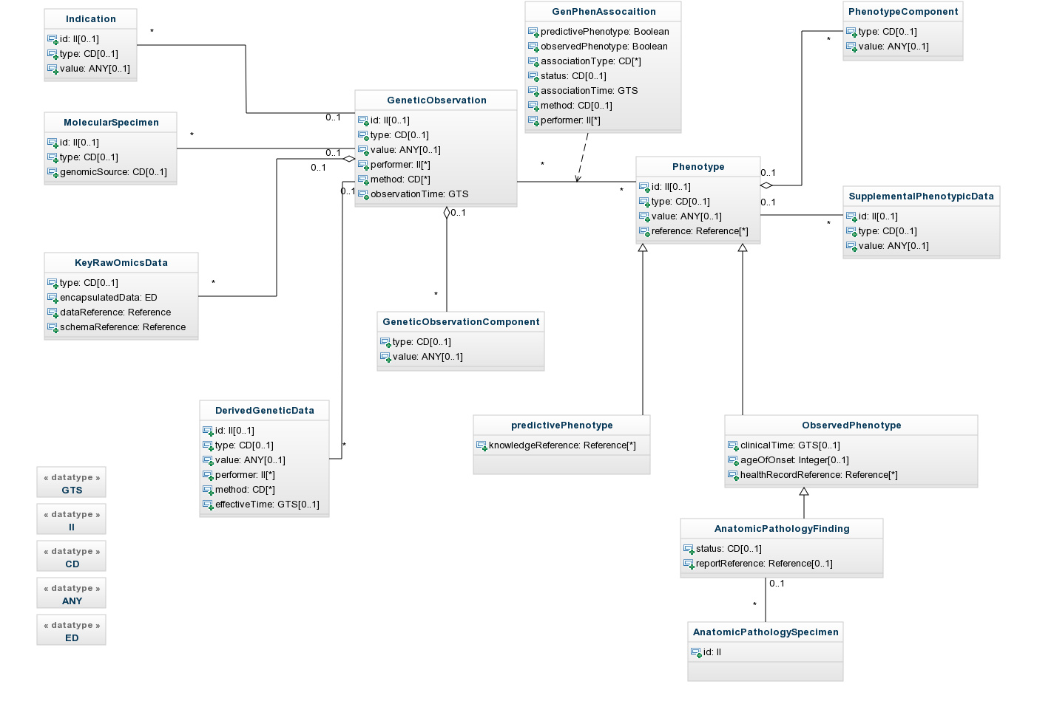
CGS DIM - Overview
The backbone:
Gen-Phen association
The genetic observation(s)
The Phenotype(s)
Encapsulated raw data
Predictive phenotype
Observed phenotype

Slide 10
Class: GeneticObservation
Representation of any observation that cannot be analytically derived from other observations made by the performer, including genetic loci in the size of a gene, e.g., genes, biomarkers, point DNA mutations, etc., as well as structural variations, e.g., large DNA deletions or duplications, etc.
Note that omics data derived from this observation, e.g., RNA, proteins, expression, etc., should be represented using the linked DerivedGeneticData class.

Slide 11
Class: Phenotype
Description:
  Representation of any data considered phenotype of the source genetic observation. For each genetic observation (e.g., variation), there could be multiple phenotypes, however, each phenotype object should represent a single phenotype. Defining a set of properties to be a 'single' phenotype might be determined by the intended utility of this phenotype, e.g. in patient care or in clinical trials or earlier on in different phases of research.
Attributes:
  id: a globally-unique id of this observation
  type: the type of phenotypic observation, e.g., drug responsiveness
  value: the actual observation (should be drawn from dedicated ontologies, e.g., Human Phenotype Ontology, http://www.human-phenotype-ontology.org/)

Slide 12
Association Class: Gen-Phen
This association class adds characteristics that cannot be represented through either side of the core association, e.g.,
  type of phenotype (observed or non-observed, e.g., predictive)
  type of relation like causality, pathogenic if phenotype is a pathology, or non-causative (benign)
  status of this relation, e.g., established, provisional, presumed, preliminary, etc.
  method of how this associated was created
  time when the association was created
  performers of this association

Slide 13
Post-coordination of Gen. and Phen. Obs.
Phenotye components
Genetic observation
components

Slide 14

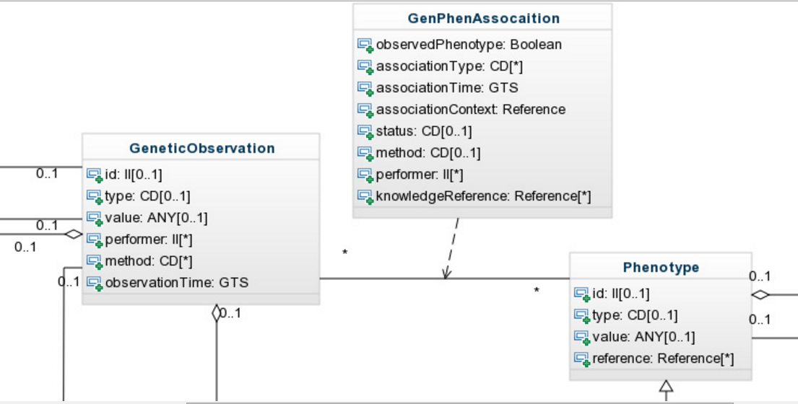
CGS DIM Core Association: ‘Gen-Phen’

Slide 15
Class: GeneticObservationComponent
Description:
  Representation of components of the core genetic observation in a post-coordinated manner, i.e., breaking it down to its primitives in order to disambiguate data held by the GeneticObservation class, e.g., an HGVS string.
Attributes:
  type: the type of genetic observation component, e.g., variation location, variation length, etc.
  value: the actual component observation, e.g., if type is variation base length then value is the actual length

Slide 16
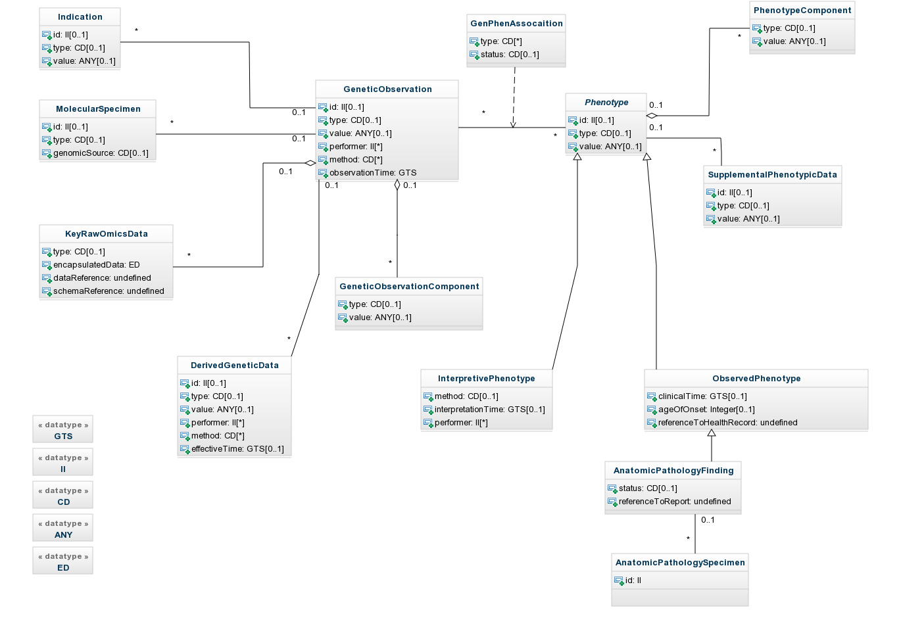
Derived Genetic Data
DerivedGeneticData: the results of downstream analysis of the source genetic observation

Slide 17
Class DerivedGeneticData
Description:
  Representing any downstream data derived from the core genetic observation (including omics data), e.g., RNA, proteins, expression, etc.
Attributes:
  id: a globally-unique id of this observation
  type: the type of observation, e.g., characteristics of the resulting protein
  value: the actual observation
  performer: e.g., unique id of the genetic lab that generated this data

Slide 18
Molecular Specimen and Indication
Indication of performing the genetic observation
Specimen used for the genetic observation

Slide 19
Encapsulated Key Raw Data Sets
Key raw data sets are encapsulated in its native format, with references to the full-blown raw data

Slide 20
Class: KeyRawOmicsData
Description:
  Representation of key data extracted from mass raw genomic data, e.g., an exon's sequence that is considered key to this clinical genomics statement, is extracted from some larger sequencing (up to whole exome squencing) and encapsulated within this statement structure. Another example: certain lines of a VCF file (preferably its 'clinical-grade' version). The encapsulated data should contain references to the full-blown raw omics data.
Attributes:
  encapsulatedData: a placeholder for the key raw omics data, e.g., DNA sequences, variants calls, expression data, etc. Could be any type of data encoding: binary, text, XML, etc.
  reference: a pointer to the repository containing the full-blown data sets out of which these key data items were `extracted from
  type: designating the notation used in the encapsulatedData attribute, e.g., VCF, FASTA, etc.
  schemaReference: a pointer to the schema governing the representation of the data in the encapsulatedData attribute

Slide 21
Predictive versus Observed Phenotype
Additional information pertinent to the core phenotype observation
Observed Phenotype, that is, observed in the individual and associated with the genetic observation
Predictive Phenotype –
a distinct observation

Slide 22
Class ObservedPhenotype (ext. Phenotype)
Description:
  This is a sub-class of Phenotype, representing a phenotype observed in the subject, e.g., if the somatic mutation is known to be the reason of positive responsiveness to some drug, then that responsiveness is an observed phenotype.
Attributes:
  clinicalTime: the effective time for the subject of this observation
  ageOfOnset: use this attribute in cases where dates are not available (e.g., in clinical genomics statements pertaining to a relative of a patient in a family health history)
  healthRecordReference: a pointer to an information system (e.g., EHR system) holding the broader contextual data of this observation (this could be implemented by guidance provided by health information exchange systems such as the specifications set out by the NwHIN in the US)

Slide 23
Class PredictivePhenotype (ext. Phenotype)
Description:
  This is a sub-class of Phenotype, representing a phenotype that is likely to be manifested in the subject, e.g, the somatic mutation is likely to cause resistance to some drug
Attributes:
  method: the method by this interpretation was made (e.g., an identified algorithm, a rule engine, a clinical decision support application/service, etc.)
  interpretation Time: the time this interpretation was made available for this Clinical Genomics statement instance)
  performer: unique id of the entity making this interpretation (e.g., clinical decision support application/service)

Slide 24
Anatomic Pathology Specimen & Findings
Anatomic pathology findings with optional reference to the full AP report
Anatomic pathology specimen (prior to DNA/RNA extraction)

Slide 25

Translational Clinical Genomics Statement
Kobayashi et al. (2005) reported a patient with advanced non-small cell lung cancer in complete remission during treatment with Gefitinib (he was Gefitinib-responsive due to somatic EGFR-mutant). However, after 2 years he got into relapse.
Clinical genomics
Re-sequencing DNA of the EGFR gene in his tumor biopsy specimen at relapse revealed the presence of a second mutation. Structural modeling and biochemical studies showed that this second mutation led to the Gefitinib resistance.
Translational
Observation
SequenceVariation
EGFR Variant id
131550.0001
Relation:
cause; evidence
Observation
ClinicalPhenotype
responsive
Medication
DrugTherapy
Gefitinib intake details: dose, time, etc.
Relation:
[subject]
Relation:
[SAS]
Observation
SequenceVariation
EGFR Variant id
131550.0006
Relation:
cause; simulation
Observation
ClinicalPhenotype
resistant

Slide 26
The End
Thank you for your attention… ☺
Questions? Contact Amnon at amnon.shvo@gmail.com
Comments of general interest should be posted to
the CG mailing list at clingenomics@lists.hl7.org

